Slide 2
Action for Children Sunday 2023
At Action for Children we see every day the transformative difference that a nurturing, supportive and loving environment makes.
This year, Action for Children Sunday focuses on this connectedness we have as humans and God’s commandment to love one another as we are loved by God.
Thank you for your prayers and for your continued commitment to help Action for Children enable thousands of children and young people to have safe and happy childhoods.

Slide 3
Terri received help from
Action for Children’s parenting support programme, Baby Steps, when it was needed most.

Slide 5
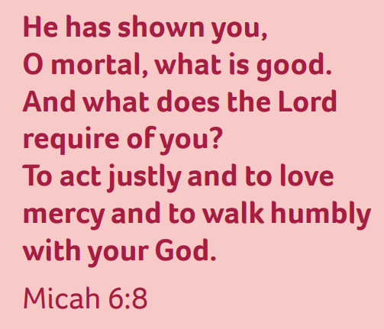
Share the Word:
Our first reading...

Slide 6
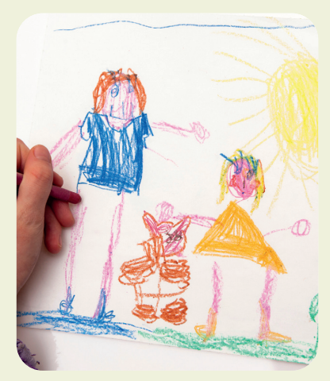
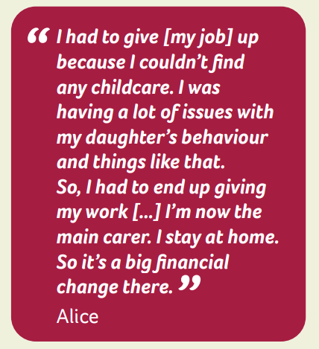

Slide 7
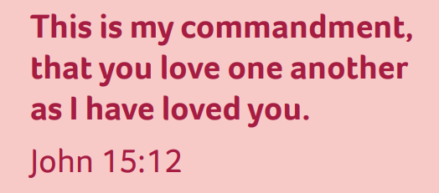
Share the Word:
Our second reading...

Slide 8
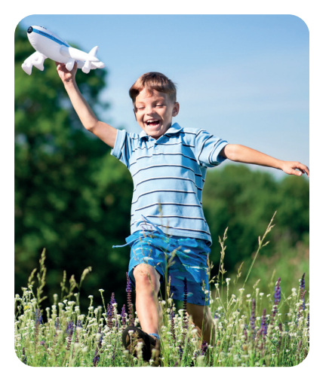

Slide 9
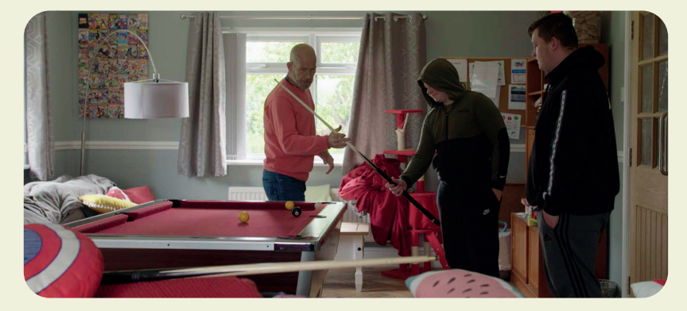
“We want to give the children the best childhood possible because they’ve obviously faced so much trauma that this is their opportunity to grow”
Caroline Morris, Tan Y Bryn Manager

